Slide 1
Introduction to Information Data Visualization
This workshop is sponsored by Visualization for Understanding and Exploration (VUE) project at the Neubauer Collegium
Kazutaka “Taka” Takahashi
kazutaka@uchicago.edu
Research Computing Center

Slide 2
Git depot for the files and today’s presentation:
https://github.com/rcc-uchicago/workshop-IntroDataVisualization/2019Summer

Slide 3
What is data visualization?
Creating appropriate and informative pictures of a dataset
Iterative exploration of data

Slide 4
Visualization Definitions
Data Visualization
Broad term for visual representations of any data
Scientific Visualization (Contact me or Teodora at RCC for this type)
Always about physical objects
Using data with an inherent spatial component
Examples: Wind tunnel vector data or three-dimensional (3D) medical images

Slide 5
Visualization Definitions
Information Visualization (I mainly focus this type this and the next two workshops)
Typically involve abstract, non-spatial data
Usually do not have inherent geometries by which to map information
E.g., financial data or document collection
Geographic Information Visualization (GIS)
Involve spatial data
Contain analysis of spatial data or tag location (and time) specific data

Slide 6
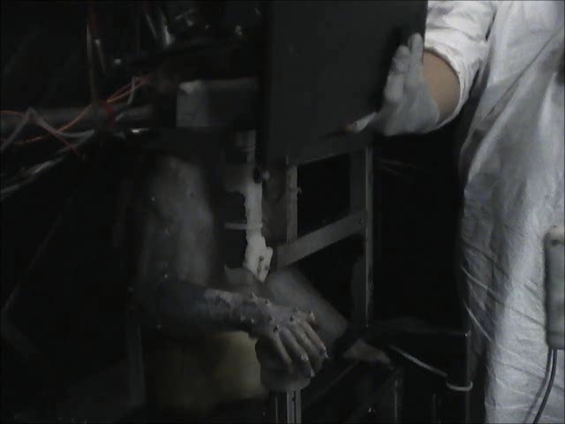
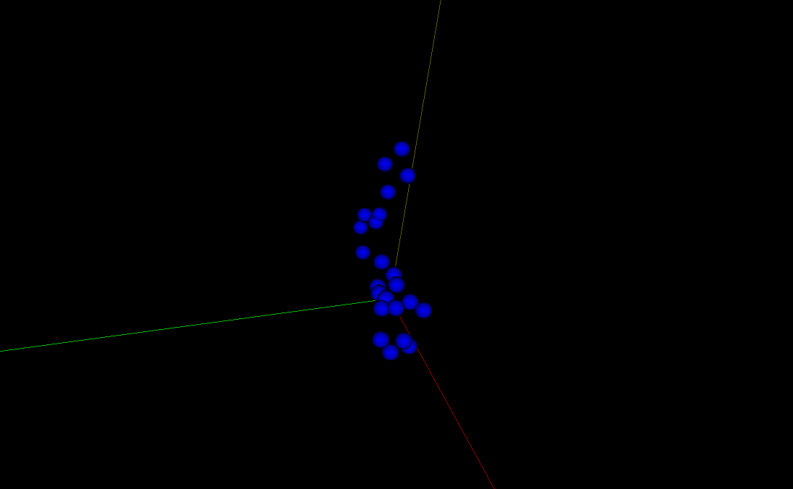
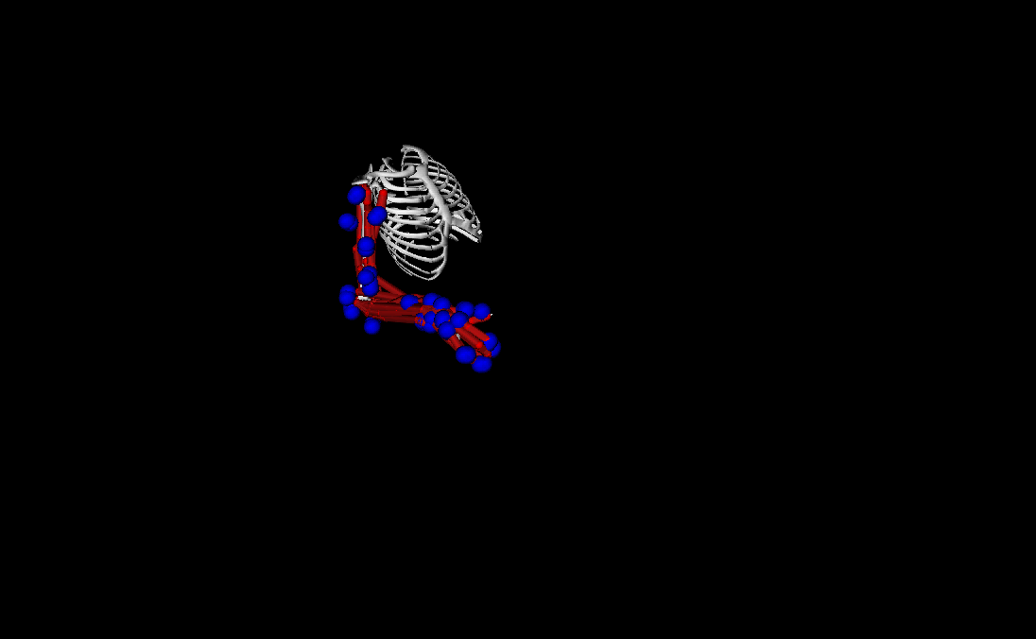
Scientific Visualization at RCC

Slide 7
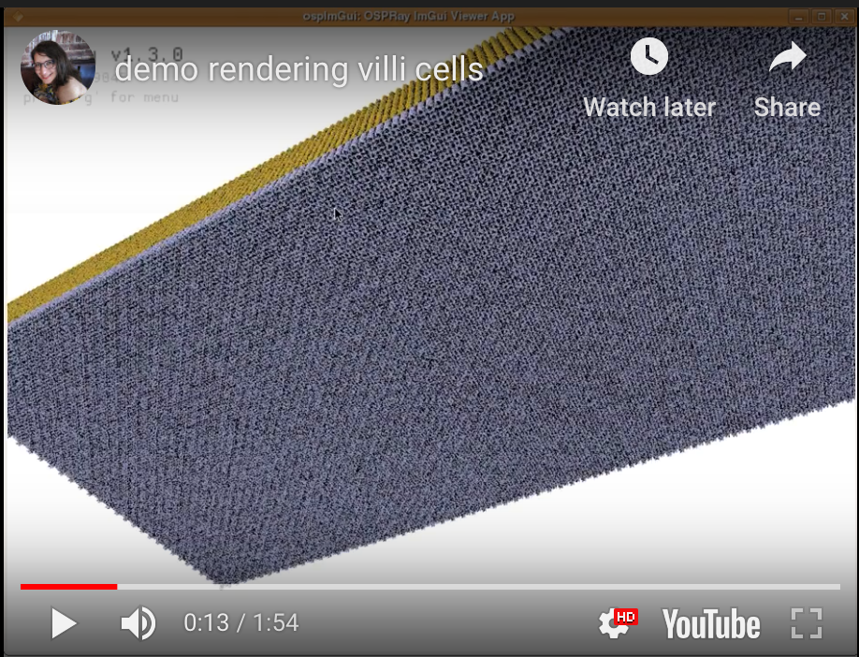
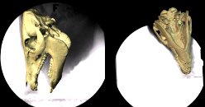
Scientific Visualization at RCC
https://youtu.be/Zgc6lKeLSsE
XROMM (various animal models available)
U Chicago by Taka and others from RCC with Prof. Ross from Department of Organismal Biology and Anatomy
VISUALIZING VILLI CELLS INSIDE HUMAN INTESTINE U Chicago by Dora from RCC with Department of Surgery,

Slide 8
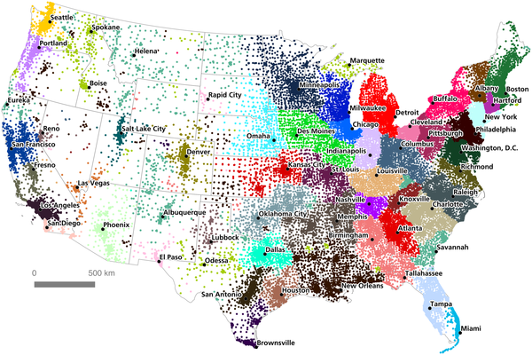

GIS - An Economic Geography of the United States: From Commutes to Megaregions
Dash Nelson G, Rae A (2016) An Economic Geography of the United States: From Commutes to Megaregions. PLOS ONE 11(11): e0166083. https://doi.org/10.1371/journal.pone.0166083
https://journals.plos.org/plosone/article?id=10.1371/journal.pone.0166083

Slide 9
Information Data Visualization - Why is this important?

Slide 10
“I keep saying that the sexy job in the next 10 years will be statisticians”
Hal Varian, Chief Economist Google
New York Times, August 5th 2009
Statisticians will never have a sexy job. Data-powered storytellers will.

Slide 11
Visualization -> “Sanity” Check Statistics -> Quantify the “hunch”
Visualization != Sexy Pictures
Visualization -> Story telling (with your message)

Slide 12
What are the stories? What are data looking like?

Slide 13
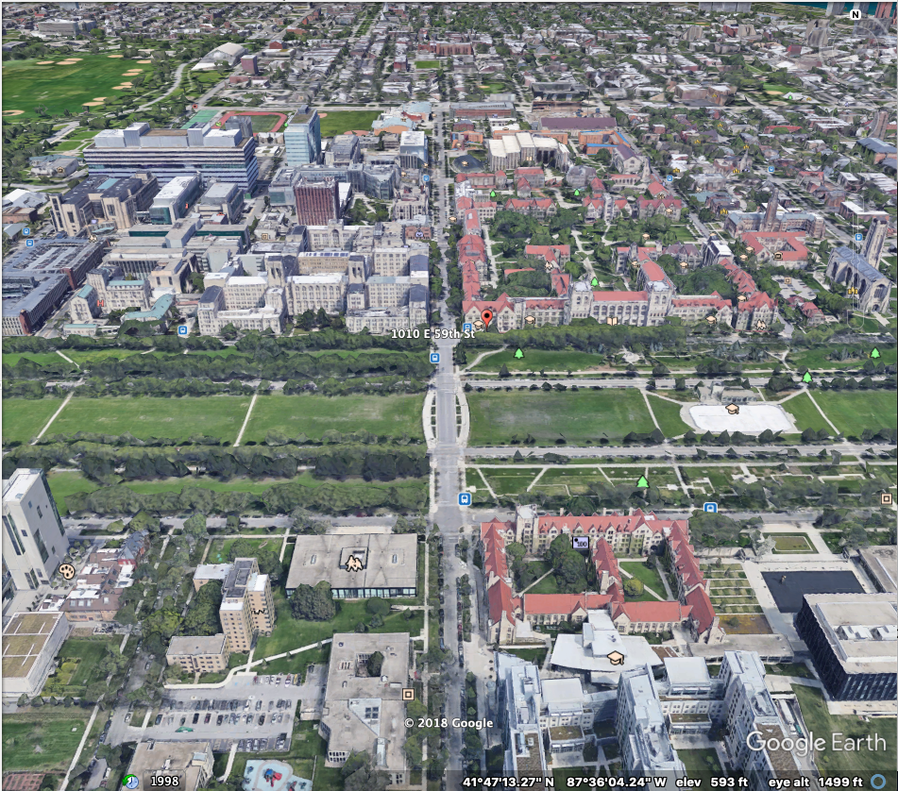
Notes:
Let’s talk about some of the visualization created by our department at The University of Chicago

Slide 14
RCC’s Visualization for Humanity and Social Science
VUE - Visualization for Understanding and Exploration

Slide 15
Themes
Text (Information) data visualization
Spatial data visualization
Example - 1919 Chicago Riot project (Prof. John Clegg)

Slide 16
Example - 1919 Chicago Riot
Mapping the 1919 Chicago Riot is a collaborative project to visualize the 1919 riot combining original historical sources with modern geospatial technologies. We have compiled official reports and contemporary newspaper articles to map and detail incidents of deaths, injury and arson that occurred during the riots, as well as geo-locating original photographs taken during that time.
For more information about the riot: https://chicago1919.org

Slide 17
Workflow
PI’s group collect data (incident, geo-location, descriptions, and images)
RCC worked on coming up with a data workflow
Data format
Data storage (Google Drive)
Assist geocoding and georeferencing (using current and historical maps)
Mapping data (Google drive) -> arcGIS
Making time evolving movie of the incidents
Put the contents on a website
Final product

Slide 18
Another example:
History of Chicago homicide
Working with Prof. Robert Vargas in the Department of Sociology to analyze and visualize history of Chicago homicide data
Example

Slide 19
More information about VUE
More questions?
https://vue.rcc.uchicago.edu
The call for the next academic year 2019-2020 will go out soon - and focus will be on geographic or spatial data visualization
Contact: Kazutaka Takahashi (kazutaka@rcc.uchicago.edu)
Or vue@rcc.uchicago.edu

Slide 20
What are the stories to tell?
Two surveys:
Temporal evolution of world poverty
Life Expectancy

Slide 21
In the last 20 years the percent of people living in extreme poverty has…?
A
Almost doubled
B
Remained almost the same
C
Almost halved
Notes:
Extreme poverty - not having enough food for the day
Ask the participants to respond to the question
Compute the % of number of answers for each questions

Slide 22
What is the average life expectancy at birth in world today?
A
50 years
B
60 years
C
70 years
Notes:
Ask the participants to respond to the question
Compute the % of number of answers for each questions

Slide 23
Answers

Slide 24
In the last 20 years the percent of people living in extreme poverty has…?
A
Almost doubled
B
Remained almost the same
C
Almost halved
Notes:
Extreme poverty - not having enough food for the day
Ask the participants to respond to the question
Compute the % of number of answers for each questions

Slide 25
In the last 20 years the percent of people living in extreme poverty has…?
A
Almost doubled
B
Remained almost the same
C
Almost halved
Notes:
Extreme poverty - not having enough food for the day
Ask the participants to respond to the question
Compute the % of number of answers for each questions

Slide 26
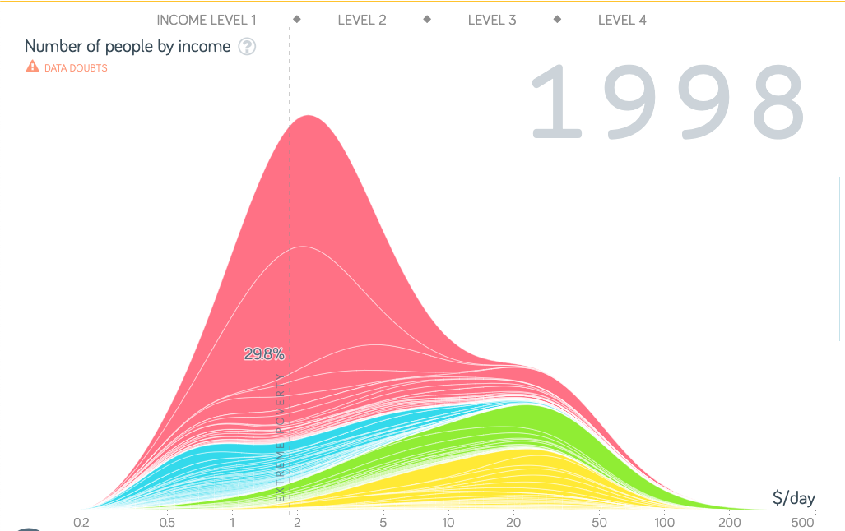

Slide 27
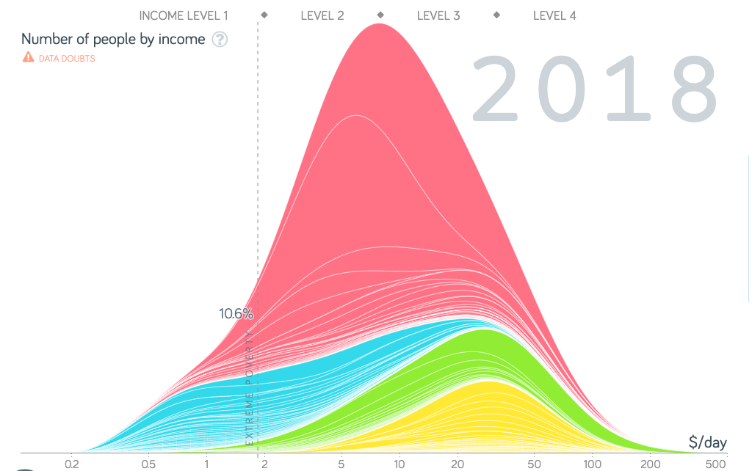

Slide 28
What is the average life expectancy at birth in world today?
A
50 years
B
60 years
C
70 years
Notes:
Ask the participants to respond to the question
Compute the % of number of answers for each questions

Slide 29
Public surveys
US
Almost doubled
A
66%
Remained about the same
B
29%
Almost halved
C
5%
Notes:
Well, surprize!

Slide 30

Public surveys
US
Almost doubled
A
66%
33%
Remained about the same
B
29%
33%
Almost halved
C
5%
33%
Notes:
The chimpanzees did better
Why do you think that the chimps did better? (e.g., There must be preconceived ideas)
Many in the rich countries they think that they can never end extreme poverty. Of course they think so, because they do not know what has happened.
The first thing to think about the future is to know about the present

Slide 31
Public surveys
US
Almost doubled
A
66%
33%
Remained about the same
B
29%
33%
Almost halved
C
5%
33%
Notes:
Where we are situated?

Slide 32
What is the average life expectancy at birth in world today?
A
50 years
B
60 years
C
70 years
Source: http://esa.un.org/unpd/wpp/unpp/panel_indicators.htm
Notes:
There has been a 10-year rise in life expectancy over the past five decades, thanks to great advances in healthcare across the world.

Slide 33
Public surveys
Sweden
A
50 years
24%
B
60 years
25%
C
70 years
22%
Sources for survey results
SWE & NOR: http://www.gapminder.org/GapminderMedia/wp-uploads/Novus-Gapminder-Ignorance-Survey-SWE-NO-nov_dec_20131.pdf
US: http://www.novus.se/media/29390/novus-gapminder_ignorance_survey_us_nov_2013.pdf
Notes:
Let’s see how we did.
This is what Sweden population answered

Slide 34
Public surveys
Sweden
Norway
A
50 years
24%
14%
B
60 years
25%
59%
C
70 years
22%
26%
Sources for survey results
SWE & NOR: http://www.gapminder.org/GapminderMedia/wp-uploads/Novus-Gapminder-Ignorance-Survey-SWE-NO-nov_dec_20131.pdf
US: http://www.novus.se/media/29390/novus-gapminder_ignorance_survey_us_nov_2013.pdf
Notes:
This is what Sweden and Norway population answered

Slide 35
Public surveys
Sweden
Norway
A
50 years
24%
14%
33%
B
60 years
25%
59%
33%
C
70 years
22%
26%
33%
Sources for survey results
SWE & NOR: http://www.gapminder.org/GapminderMedia/wp-uploads/Novus-Gapminder-Ignorance-Survey-SWE-NO-nov_dec_20131.pdf
US: http://www.novus.se/media/29390/novus-gapminder_ignorance_survey_us_nov_2013.pdf
Notes:
Let’s see how we did.
Thi is what the chimpanzees answered
Chimpanzees are the random

Slide 36
Public surveys
US ?
Sweden
Norway
A
50 years
24%
14%
33%
B
60 years
25%
59%
33%
C
70 years
22%
26%
33%
Sources for survey results
SWE & NOR: http://www.gapminder.org/GapminderMedia/wp-uploads/Novus-Gapminder-Ignorance-Survey-SWE-NO-nov_dec_20131.pdf
US: http://www.novus.se/media/29390/novus-gapminder_ignorance_survey_us_nov_2013.pdf
Notes:
Where do you think that we locate US?

Slide 37
Public surveys
Sweden
Norway
US
A
50 years
24%
14%
33%
11%
B
60 years
25%
59%
33%
36%
C
70 years
22%
26%
33%
53%
Sources for survey results
SWE & NOR: http://www.gapminder.org/GapminderMedia/wp-uploads/Novus-Gapminder-Ignorance-Survey-SWE-NO-nov_dec_20131.pdf
US: http://www.novus.se/media/29390/novus-gapminder_ignorance_survey_us_nov_2013.pdf
Notes:
Well, surprize!

Slide 38
Public surveys
Sweden
Norway
US
A
50 years
24%
14%
33%
11%
B
60 years
25%
59%
33%
36%
C
70 years
22%
26%
33%
53%
Sources for survey results
SWE & NOR: http://www.gapminder.org/GapminderMedia/wp-uploads/Novus-Gapminder-Ignorance-Survey-SWE-NO-nov_dec_20131.pdf
US: http://www.novus.se/media/29390/novus-gapminder_ignorance_survey_us_nov_2013.pdf
Notes:
Where are we here?
Are we beaten by the chimps?
We don't understand how the US public could get this question so well, while they share the same ignorance pattern as the other countries when it comes to most global knowledge questions. Here’s what we believe that may explain why many people get this question wrong.
The improved health status across the world is little known. This transition took many years and what the old generation in Nordic countries learned when going to school is no longer true. But this should apply to US as well…. We are puzzled
The recent increase in global life expectancy across the world is one of those macro trends that seldom get reported in news media, because they happen too slowly and they are never associated with any news-worthy event. They go on for decades but the public are unaware of it.
The wrong answers may be explained by the common misconception that a majority of people are still very poor. Roughly 1.5 billion people are extremely poor. Terribly poor. But the majority (other 5.5 billion people) live in middle or high income countries where basic health care is available to almost everybody. But the fact that so many are still poor, makes it difficult to realize that the average situation has improved enormously.

Slide 39
Preconceived ideas
World's Income Distribution
Notes:
Talk about the Ignorance Project
Think about the preconceived ideas
One of the main preconceived ideas is about the world income distribution
The number o people on each income
There was a big hump here, around $1 a day, and another big hump around $15.

Slide 40
To make those data visualization with messages -

Slide 41
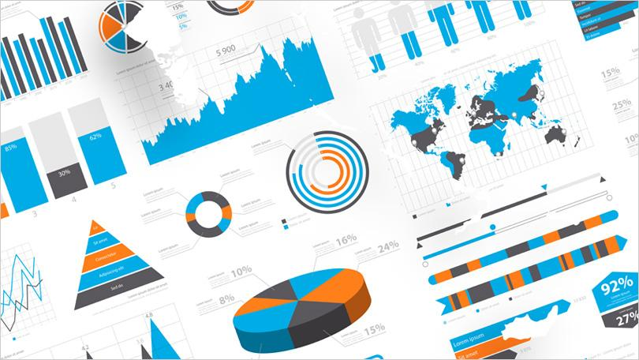
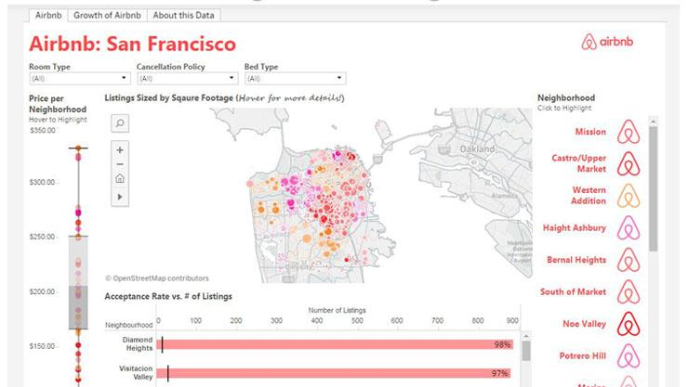
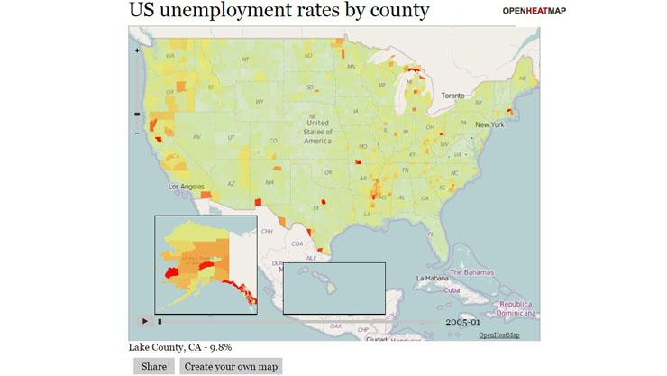
Visualization tools are everywhere
And most of them are for free!
https://www.pcmag.com/article/347315/10-free-data-visualization-tools

Slide 42
For Non-Developers/Coders: A few examples of free tools not requiring any coding:
Datawrapper is an online tool for making interactive charts.
Tableau Public is perhaps the most popular visualization tool which supports a wide variety of charts, graphs, maps and other graphics.
Raw defines itself as ‘the missing link between spreadsheets and vector graphics.
Timeline JS helps you create beautiful timelines without writing any code.

Slide 43
”Need” for Task-specific Visualization Design
LA Treinish, Task-specific visualization design, IEEE Computer Graphics and Applications, 1999
Generalized visualization systems are less suitable for environments with specific tasks and user needs
Prototypes help with defining/refining user needs
Iterative process of developing novel techniques to converge on meeting user needs
We may still want to design/code visualizations for your need!

Slide 44
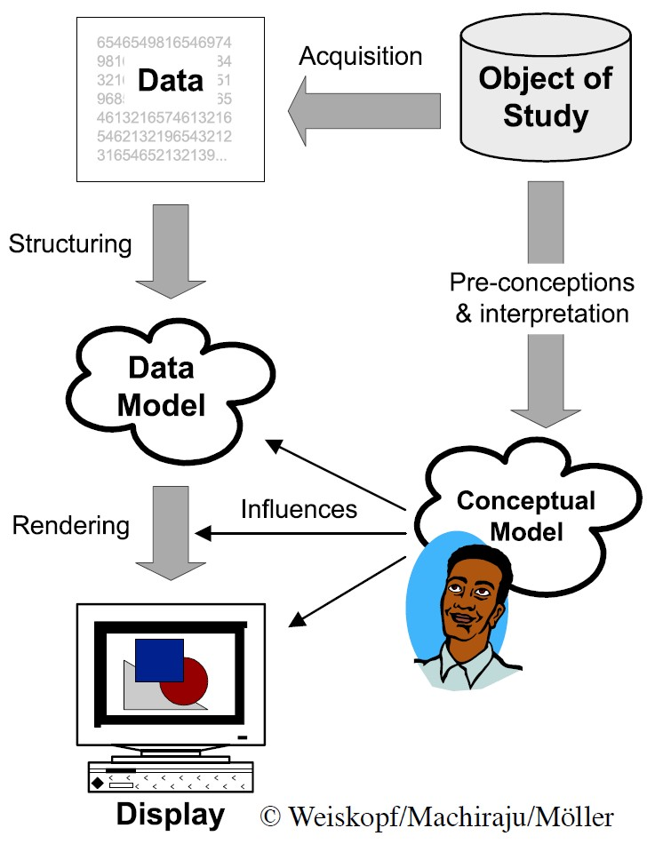
Overview of the Process

Slide 45
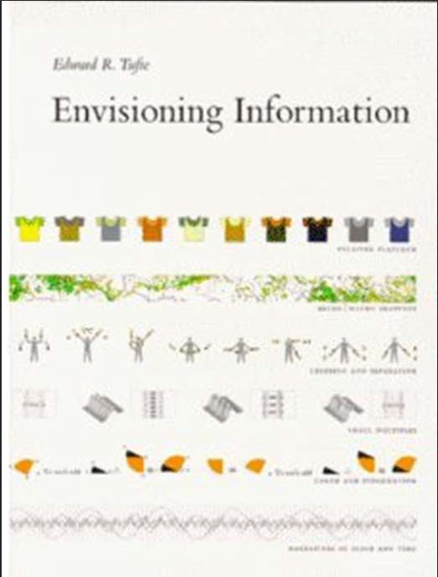
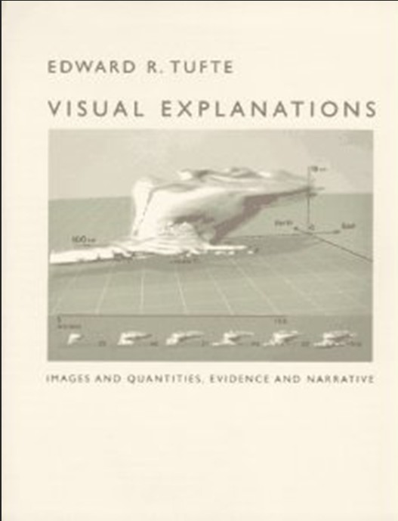
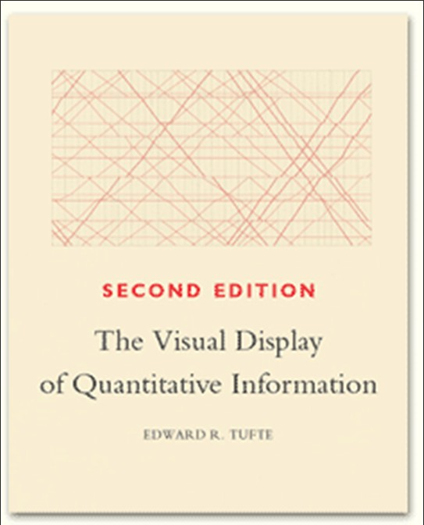
Design Excellence
“Well designed presentations of interesting data are a matter of:
Substance,
Statistics,
and Design.”
– Edward Tufte

Slide 46
Tufte’s Principles for Graphical Integrity
The representation of numbers, as physically measured on the surface of the graphic itself, should be directly proportional to the numerical quantities represented.
Clear, detailed and thorough labeling should be used to defeat graphical distortion and ambiguity.
Write out explanations of the data on the graphic itself. Label important events in the data.

Slide 47
Tufte’s Principles for Graphical Integrity
In time‐series displays of money, deflated and standardized units of monetary measurement are nearly always better than nominal units.
Show data variation not design variation
The number of information‐carrying (variable) dimensions depicted should not exceed the number of dimensions in the data

Slide 48
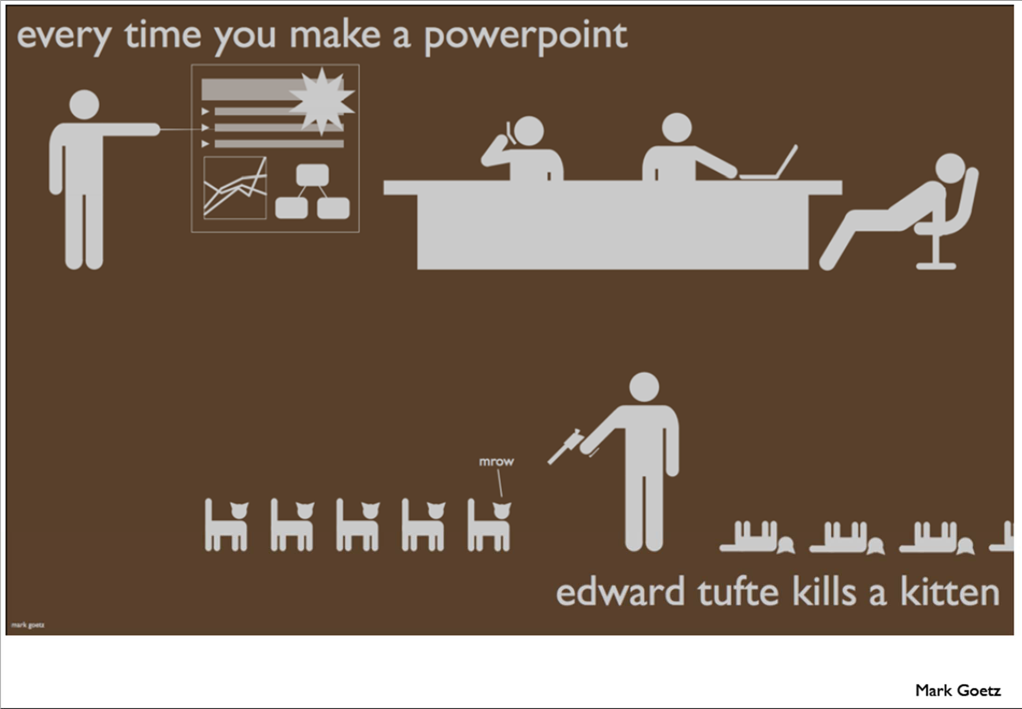

Slide 49
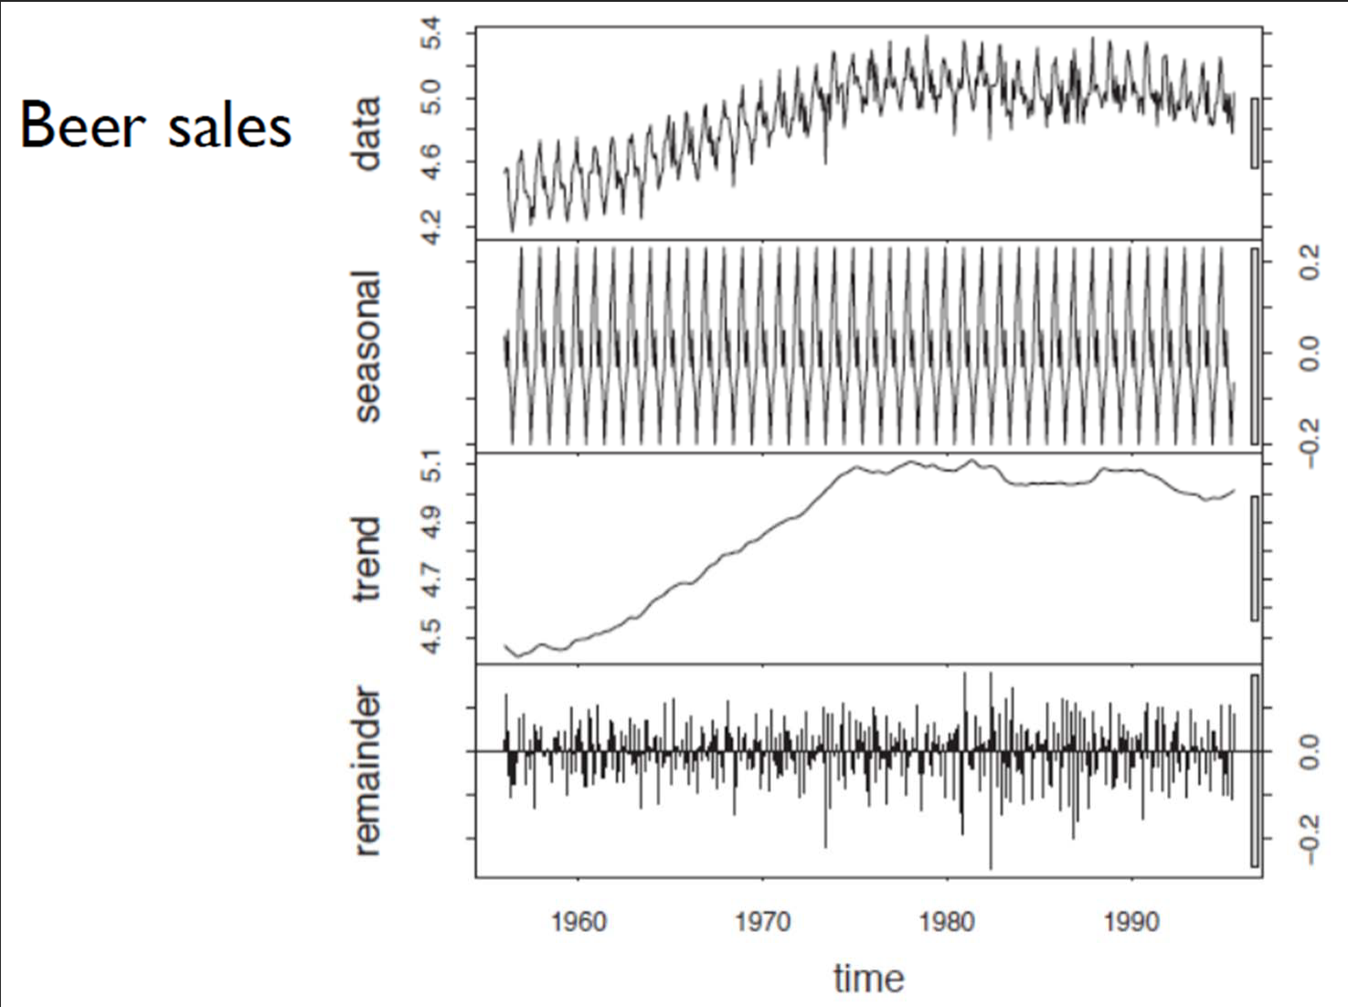
Design Principles
Use Decomposition

Slide 50
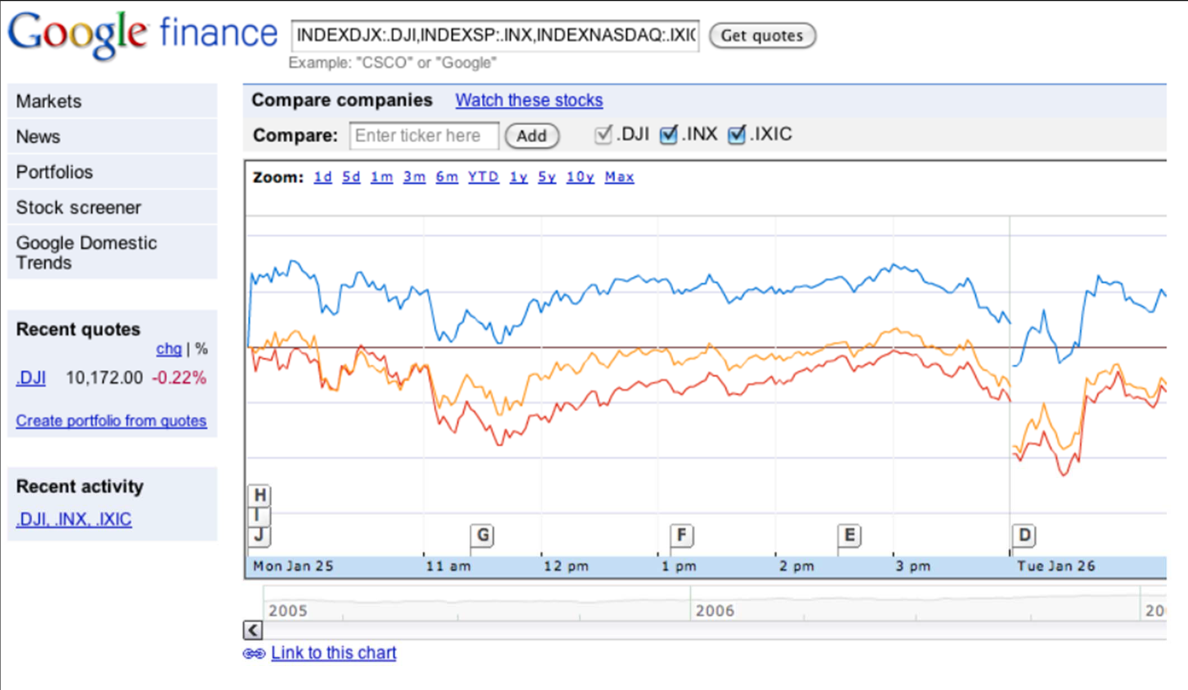
Hierarchical Display

Slide 51
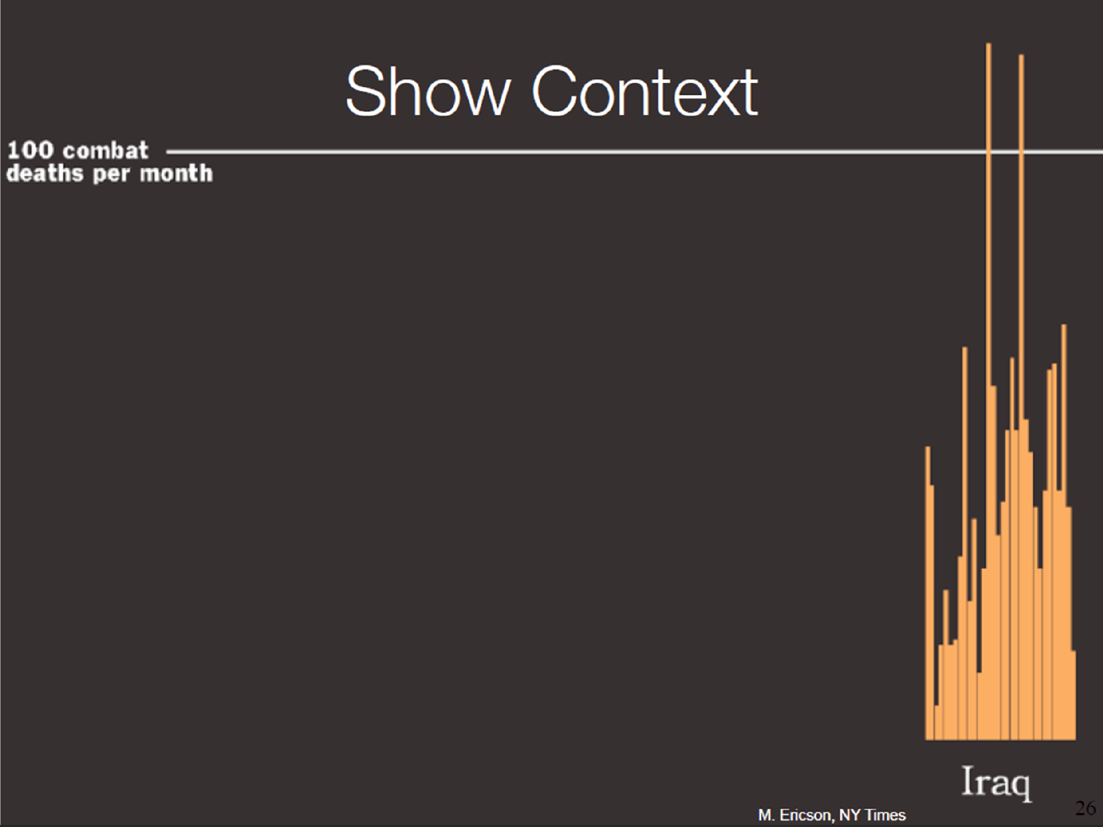

Slide 52
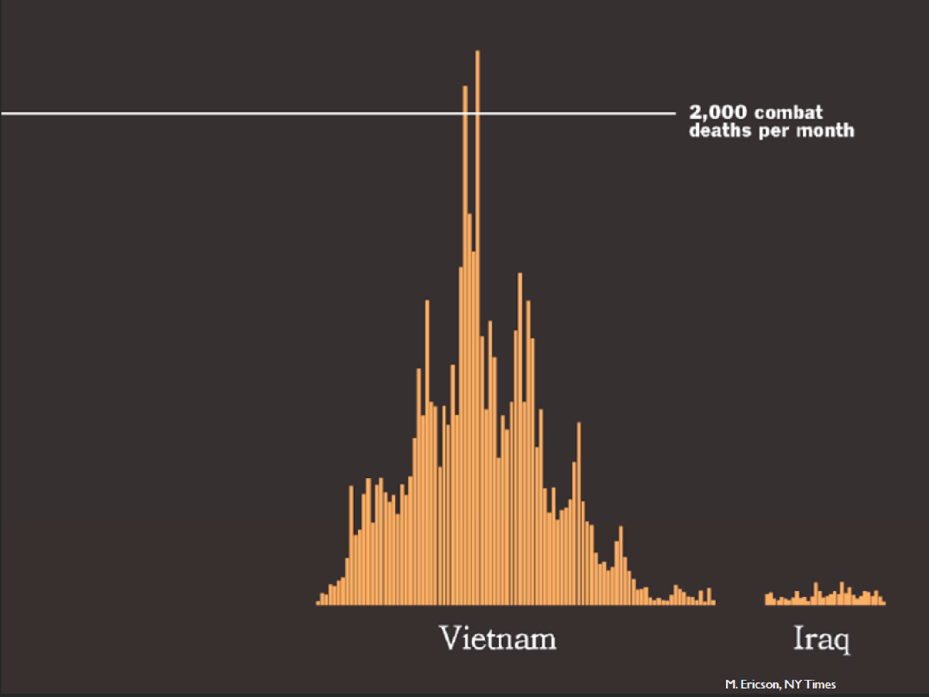

Slide 53
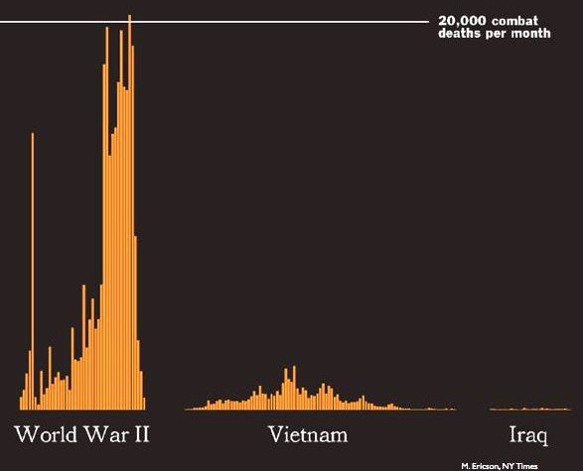
Visual Comparison

Slide 54
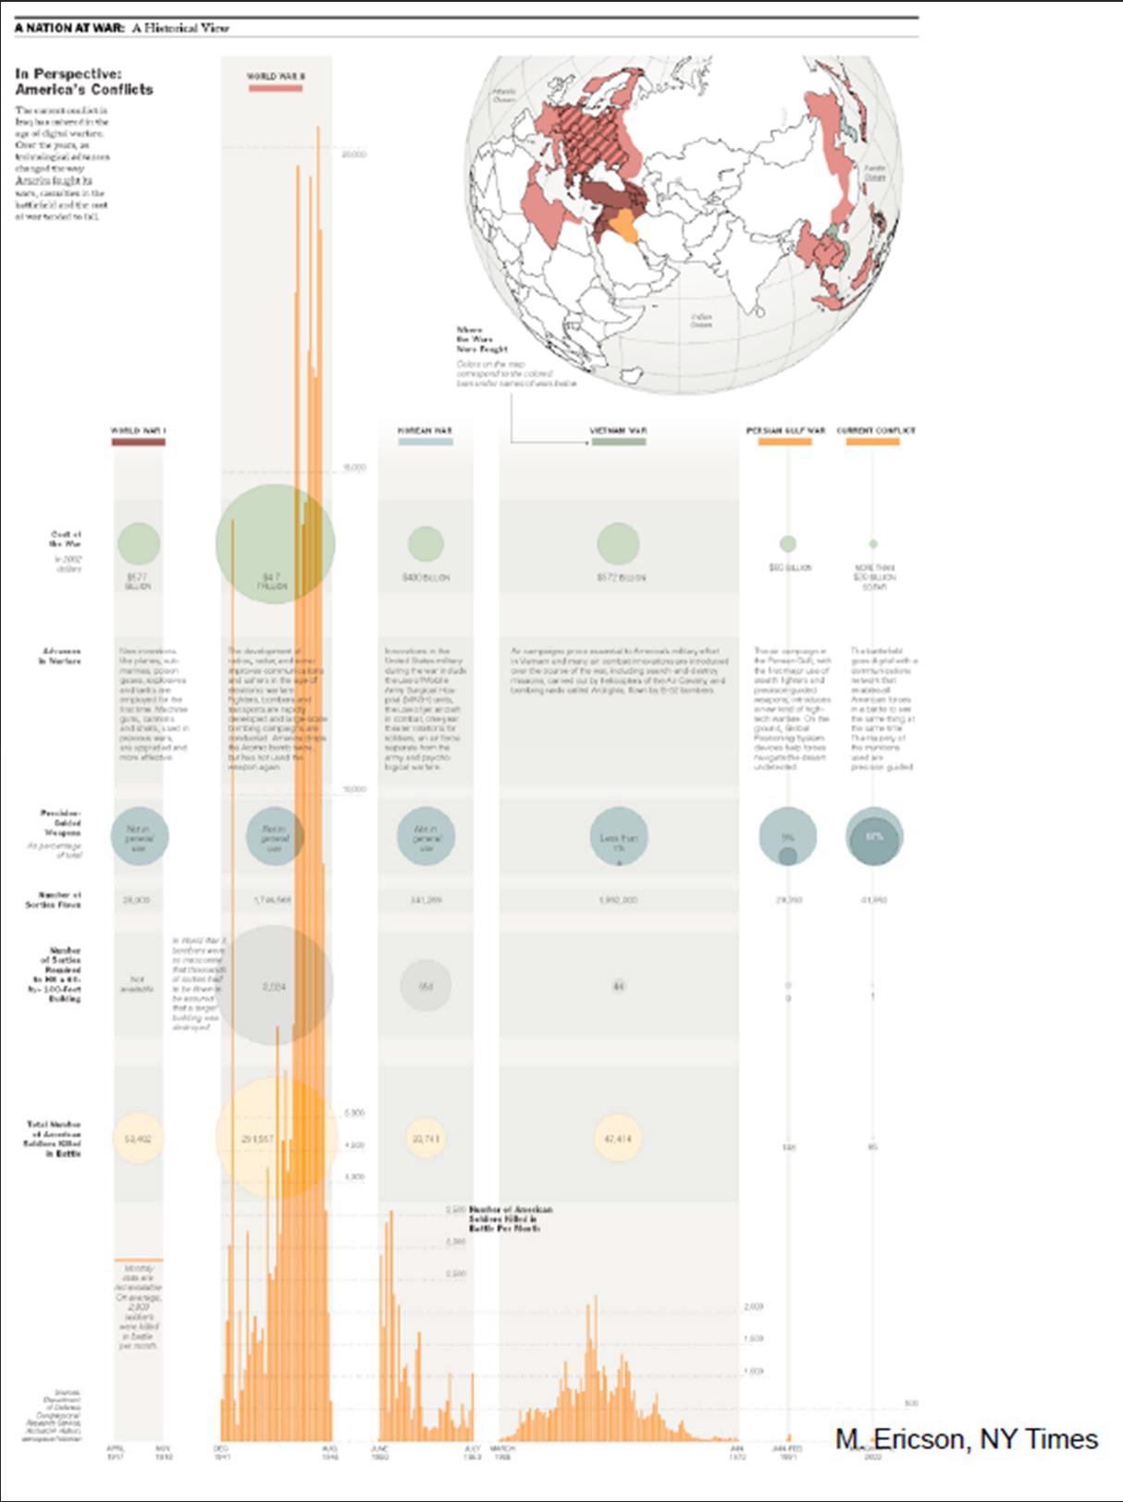
Embedding Data

Slide 55
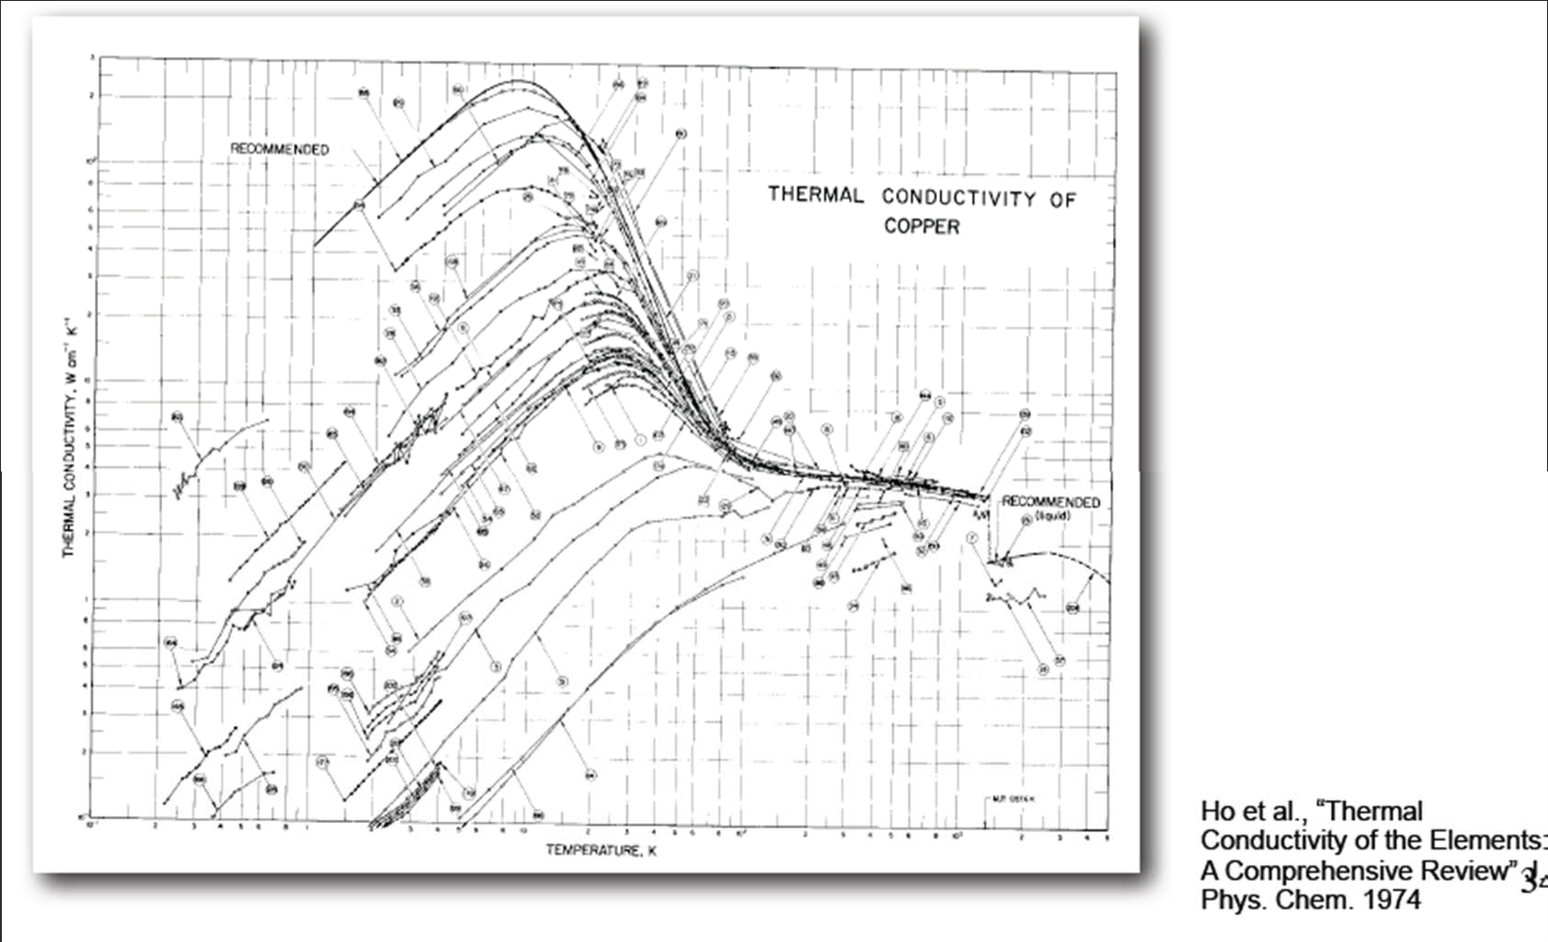
Data Density
Data density = number of entries in data array
area of data graphic

Slide 56
Fourteen Ways to Say Nothing With Scientific Visualization
Al Globus , Eric Raible, Fourteen Ways to Say Nothing With Scientific Visualization, Computer, v.27 n.7, p.86‐88, July 1994.
Negative rhetoric to convey message
Very interesting read
Thoughts evoking!
Good packages contain “classes” that enable us to say something meaningful

Slide 57
Fourteen ways..
Include a color legend – Class
Annotate – (Labeling and Annotation) – Class
Mention Error Statistics
Don’t smooth/alter your data
Provide performance comparisons
Be faithful to your representation – Class
Learn about the data domain‐

Slide 58
Fourteen ways..
Compare results with other vis techniques
Use visualization systems if available
Cite references to data – Class
Show multiple datasets to convince reader
Be fair to your vis technique (don’t show viewing angle that hides "blemishes")
Don’t try fancy graphics stunts to hide ugliness – Class
Be fair about extension to 3D ‐ Class

Slide 59
Overview of the Process

Slide 60
Visualization Pipeline
Simulation
Filtered
Data
Database
Raw Data
Mapping
Visualize
Acquisition
(scanners,
sensors, …)
Filtering
Rendering

Slide 61
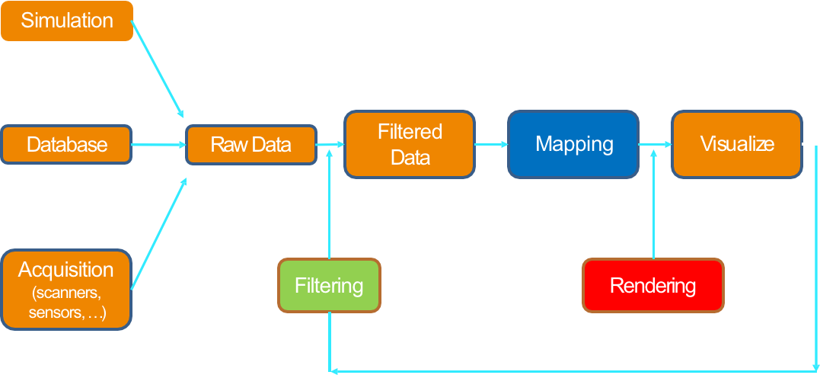
Filtering
Data input -> Data output
Data format conversion
Clipping/cropping/denoising
Slicing
Resampling
Interpolation/approximation
Classification/segmentation

Slide 62
Filtering (or parsing for text data)
Verma, K., M. Ranjan and P. Mishra. (2015) "Text mining and information professionals: Role, issues and challenges," 2015 4th International Symposium on Emerging Trends and Technologies in Libraries and Information Services
Over 90% of the information available is in unstructured and semi-structured forms
which is very difficult to search.
Text mining is a tool to help Information professionals
to find the relevant information and deliver to its users
Prescott, A. (2013) "Bibliographic records as humanities big data," 2013 IEEE International Conference on Big Data.
Superficially, bibliographic records appear to be a homogenous dataset
Examination reveals that records change through time
There are methods to disaggregate such data
Analogous to those used in some scientific disciplines

Slide 63
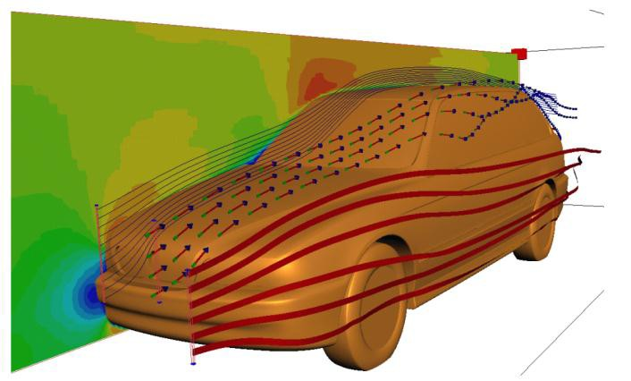
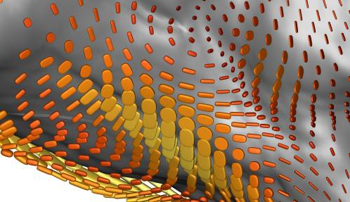
Mapping
Data input -> Graphical Primitives
Scalar field -> Surface, Lines
Vector field -> Vectors/Arrows/Streamlines
Tensor field -> Tensor glyphs/Ellipsoids
3D Field -> volume visualization
High dimensional data -> Map to 2D/3D
Image credits: SCI Utah, Daniel Weiskopf

Slide 64
Rendering
Render graphics primitives such as
Points
Lines
Surfaces
Volumes
With attributes such as
Color
Texture
Transparency

Slide 66
We will focus on Python
One of the most popular data science programming languages
Limit ourselves to use
Matplotlib
Bokeh
Holoview and other modules (especially in the context of network visualization)

Slide 67
matplotlib
Python’s version of Matlab plotting

Slide 68
How matplotlib Draws

Slide 69
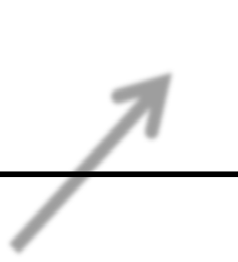
Figure object
Figure

Slide 70







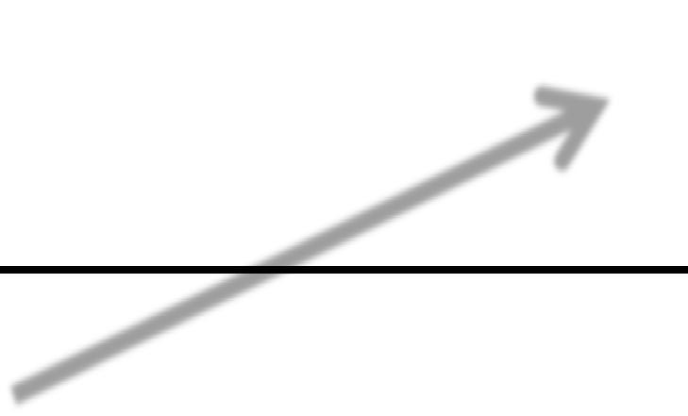
Subplot object
Draw in here
Subplot
Draw in her
e
Figure

Slide 71
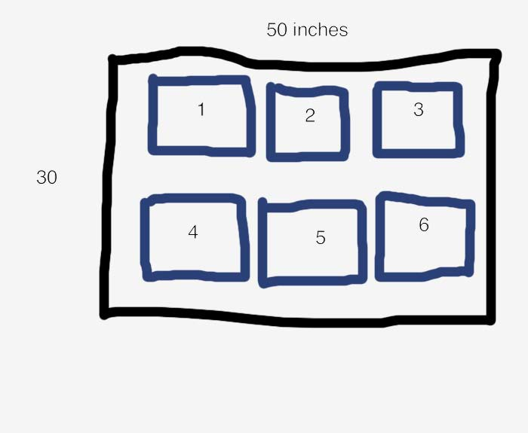
figure.add_subplot(2, 3, 1)
2
rows
3 columns

Slide 72

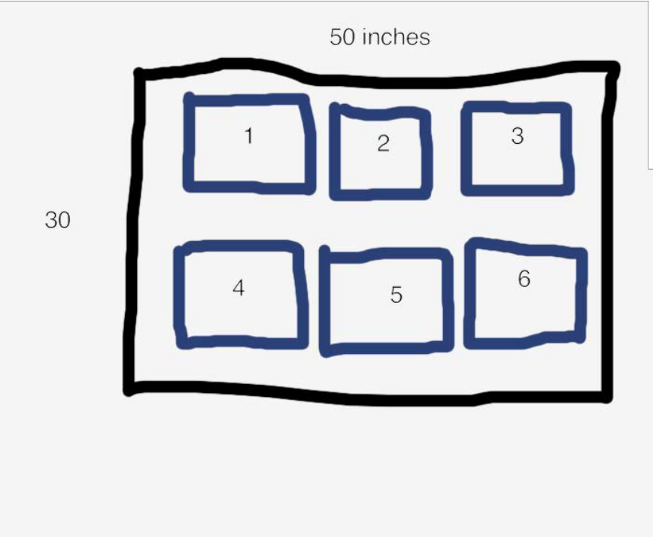

figure.add_subplot(2, 3, 1)
2
rows
3 columns

Slide 73
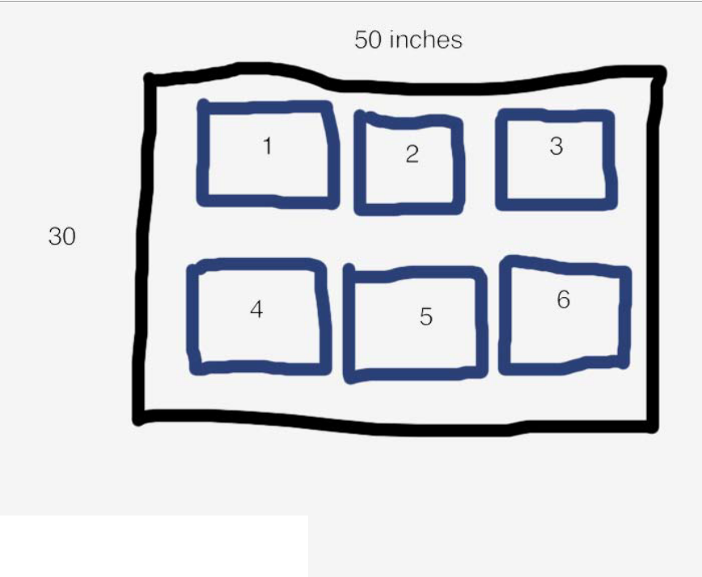



figure.add_subplot(2, 3, 1)
2
rows
3 columns
3

Slide 74
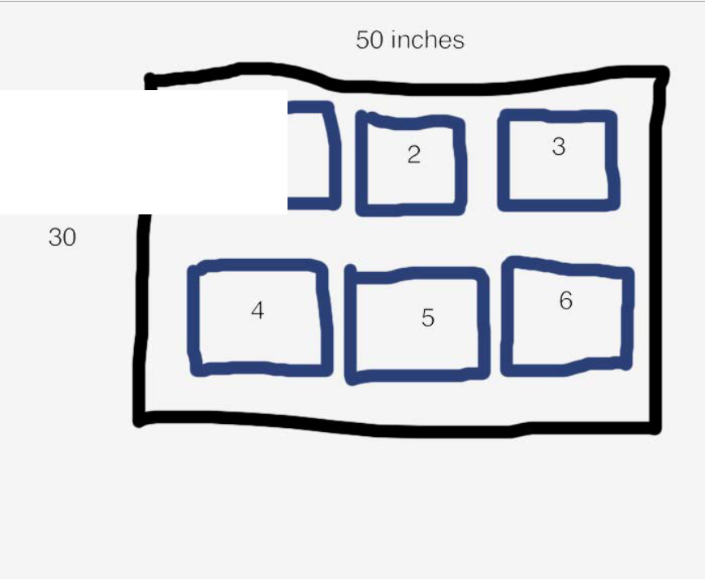
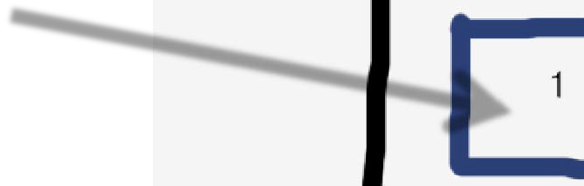
figure.add_subplot(2, 3, 1)
1
2
rows
3 columns

Slide 75
Charting Library
subplot.bar()
subplot.plot()
subplot.scatter()
subplot.boxplot()

Slide 76


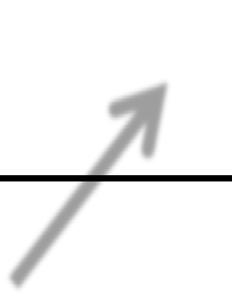
Lines
Subplot
Figure

Slide 77




Boxes
Subplot
Figure

Slide 78


Polygons
Subplot
Figure

Slide 79
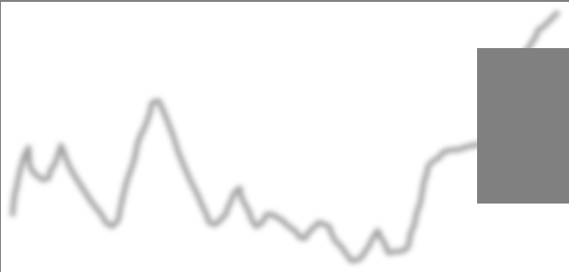



Overlaps
Subplot
Figure

Slide 80
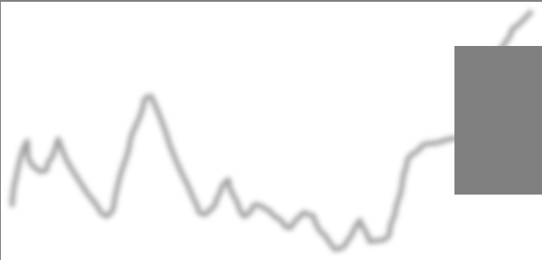

Overlaps
Subplot
Figure

Slide 81
Examples

Slide 82
Bokeh

Slide 83
Examples

Slide 84
Example on Colab
Visualize reported incidents of crime in Chicago
https://bit.ly/2xVldm5
Dataset: https://bit.ly/2xSv4Jx

Slide 85
Network visualization

Slide 86
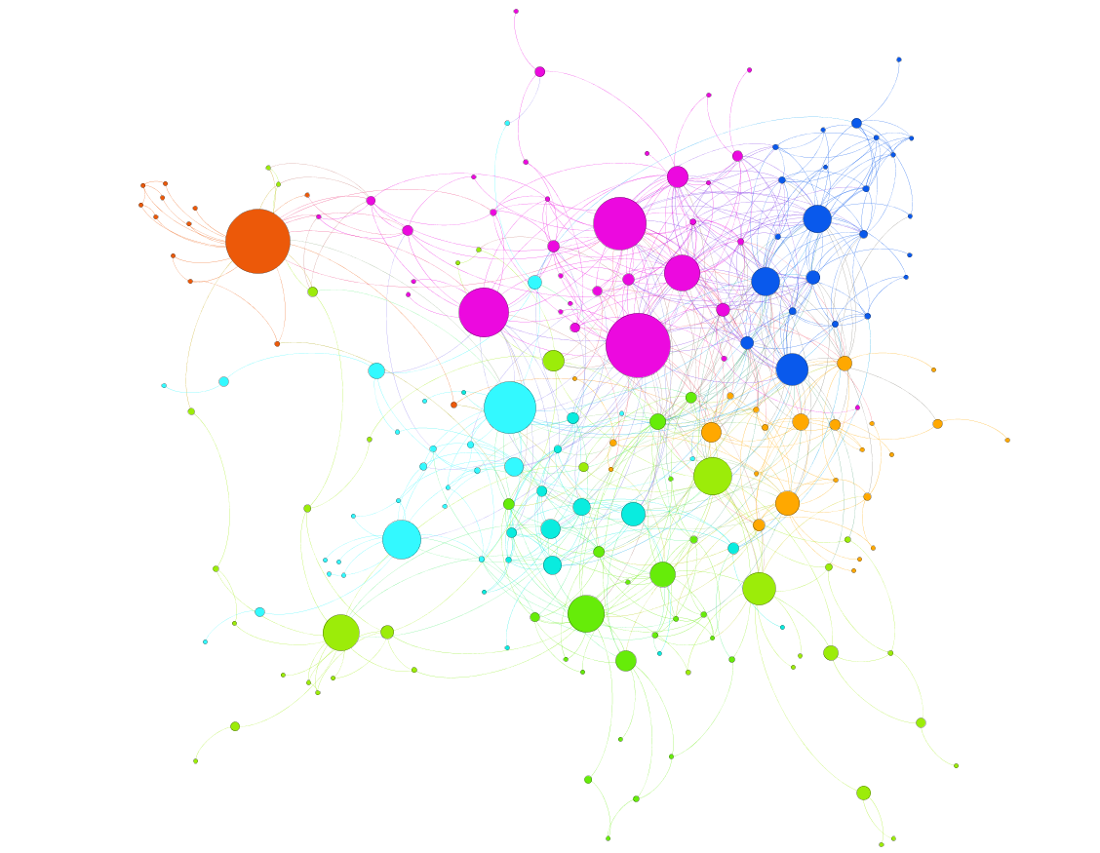
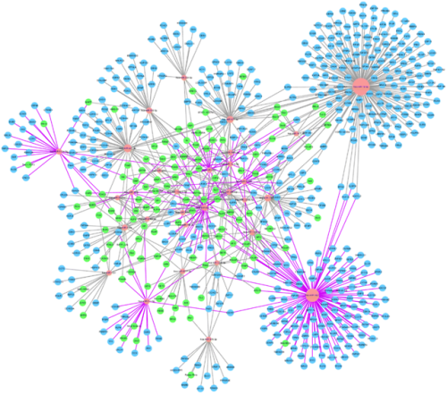
Many tools are available -
Cytoscape
Gephi
Facebook volunteer group network visualization in Gephi
By Nodus lab
MicroRNA expression profile of urinary exosomes in
Type IV lupus nephritis complicated by cellular crescent.
Li et al, J Biol Res (Thessalon). 2018 Dec; 25: 16.

Slide 87
Programming packages:
Useful introductory package is igraph
(available for both Python and R):
For Python: https://igraph.org/python/
For R: https://igraph.org/r/
For Network visualization:
For Python: graphviz (for small network), NetworkX
For complehensive list:
https://github.com/briatte/awesome-network-analysis#python

Slide 88
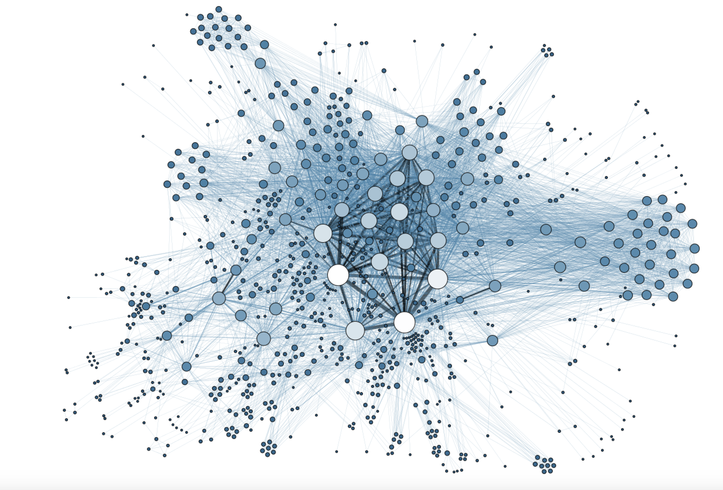
Hashtagify

Slide 89
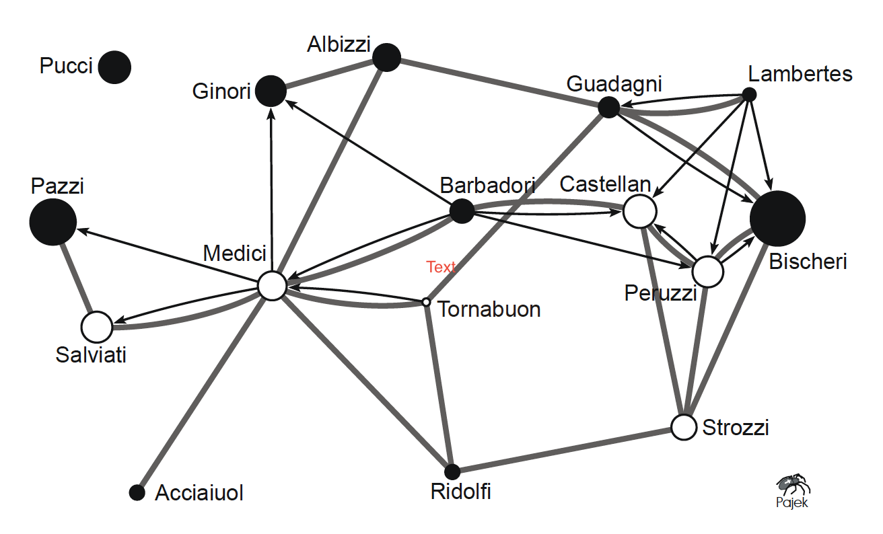
What is network?
Sociogram of marriage (grey edges) and business (black arcs) relations between 16 Florentine families (circa 1400 AD) (Prof. John Padgett, Political Science)
Notes:
Figure 1 illustrates the graph theoretical definition of a network. It shows a sociogram of marriage and business relations among 16 families in Florence (Italy) around 1400 AD. The data are part of a larger dataset collected and analyzed by John F. Padgett. In a sociogram, vertices are represented by circles, so each family is represented by a circle. Lines, connecting two circles in the sociogram, can be of two types: directed or undirected. Here, directed lines represent business relations among families. They are drawn as black arcs in Figure 1, pointing towards the more prosperous family. Marriage relations between families are undirected lines or edges in the network. They are represented by grey lines in the sociogram.

Slide 90
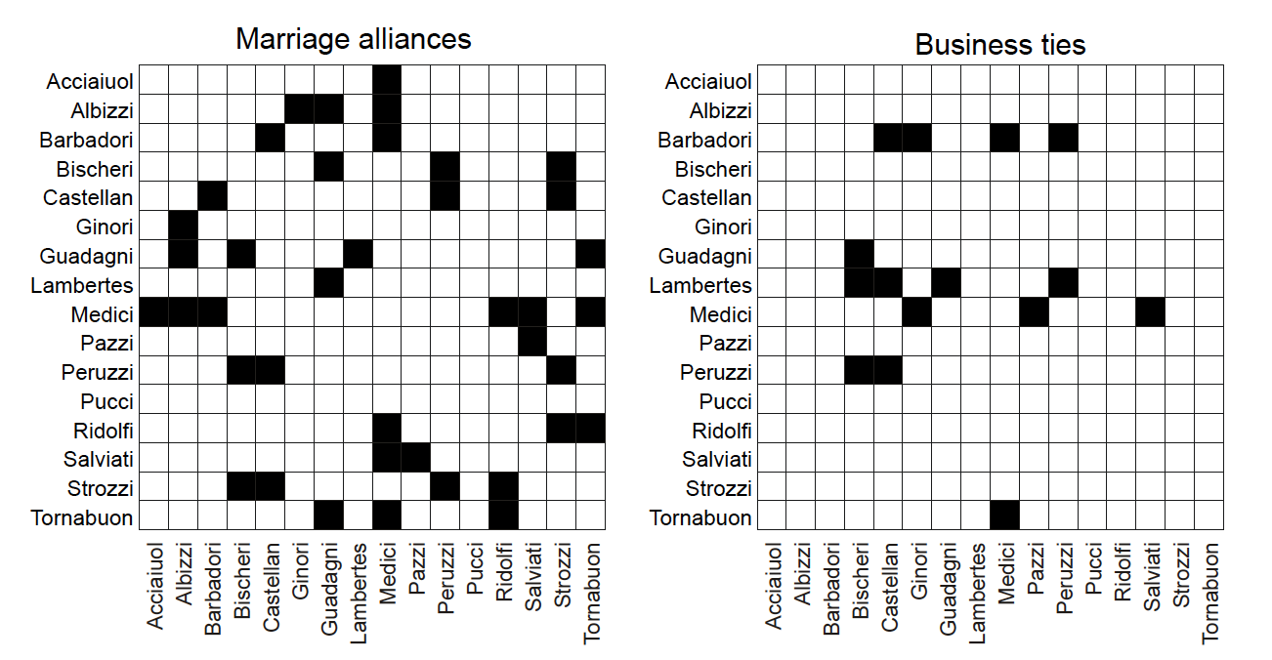
What is network?
Sociomatrices: marriage ties and business ties. (Prof. John Padgett, Political Science)
Notes:
The network of Florentine families contains two different relations. As a consequence, two families are sometimes connected by two lines: both a marriage edge and a business arc. Loops do not occur, although it is not impossible that members of the same family trade among themselves. In graph theory, a simple graph is a graph without multiple lines and, in the case of an undirected graph, without loops. A simple graph can easily be stored in a matrix, which is called an adjacency matrix or sociomatrix. So if we split the two relations in this network, we would obtain two simple graphs that can be represented by sociomatrices

Slide 91
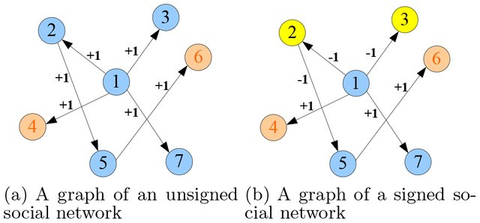
Social network visualization

Slide 92
What is network theory?
Or rather, what we want to cover today is an introduction of graph theory which deals with representations and analysis of networks
I will cover this topic during academic year

Slide 93
Examples

Slide 94
Join the RCC's image analysis and visualization Slack team
Notes:
An image is not just an arbitrary function, these images are actually projections of 3D scenes, of 3D points

Slide 95
rcc-visualization.slack.com/signup

Slide 96
Thank you so much!
Contact: Kazutaka Takahashi (kazutaka@rcc.uchicago.edu)

Slide 97
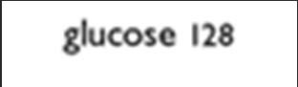
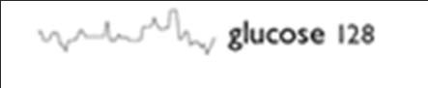
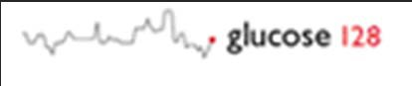
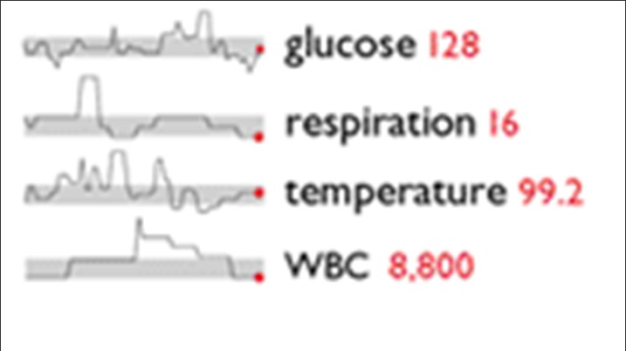

Data Density ‐ Sparklines
Sparklines are simple, word‐sized graphics
Show trends and allow users to understand the presented data better
Shows past 80 readings
Highlights specific data element
Shows normal range of glucose
Credits: Edward Tufte, Beautiful Evidence

Slide 98
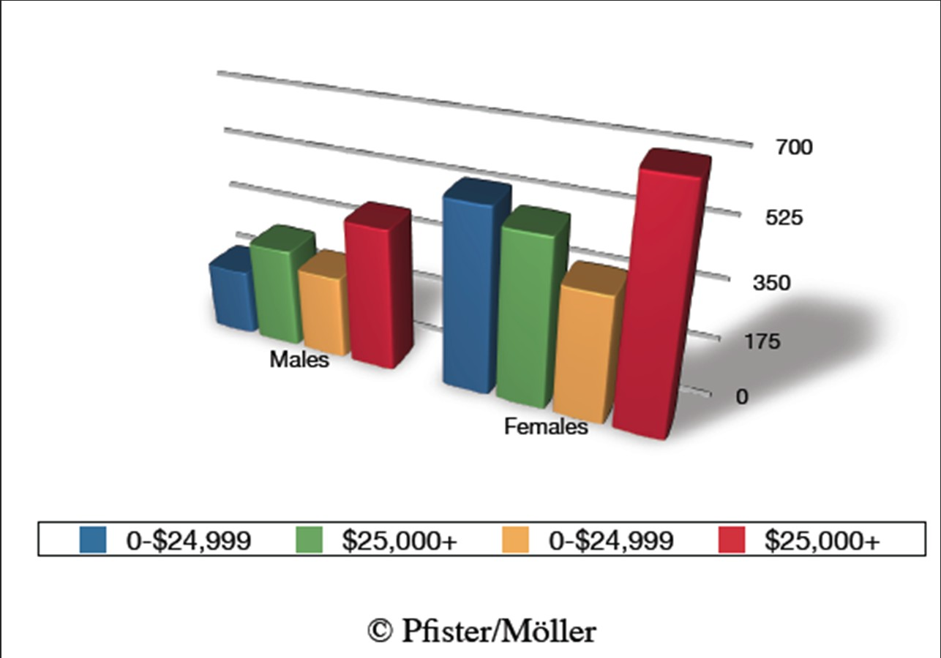
Maximize Data‐Ink Ratio
Data‐ink = ink used to show data
Data‐ink ratio = data‐ink/ total ink used

Slide 99
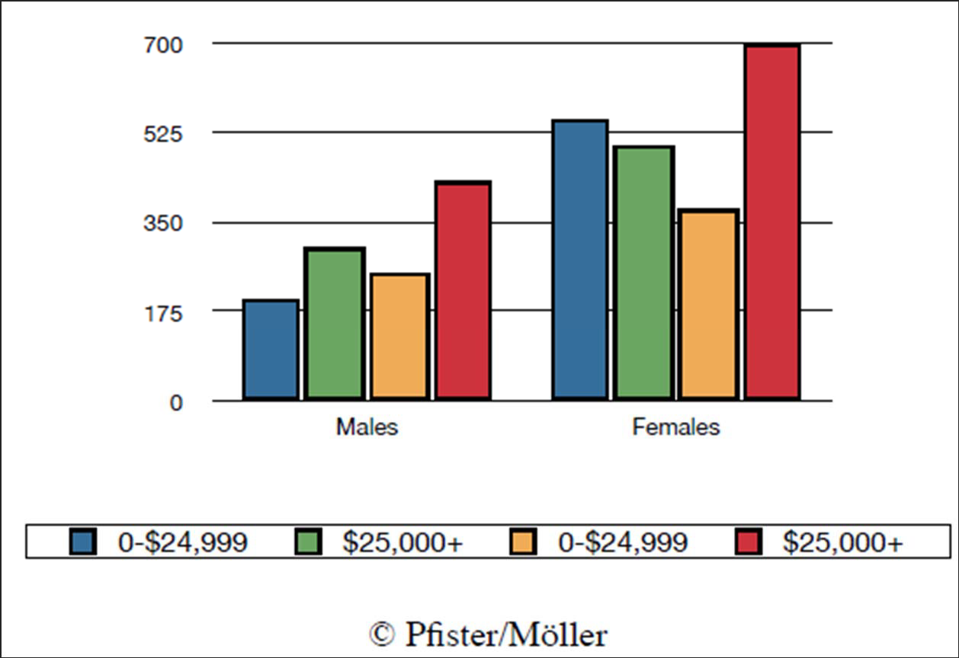
Maximize Data‐Ink Ratio
Data‐ink = ink used to show data
Data‐ink ratio = data‐ink/ total ink used

Slide 100
The Basics of the basics of plotting data
blog.okcupid.com
100

Slide 101
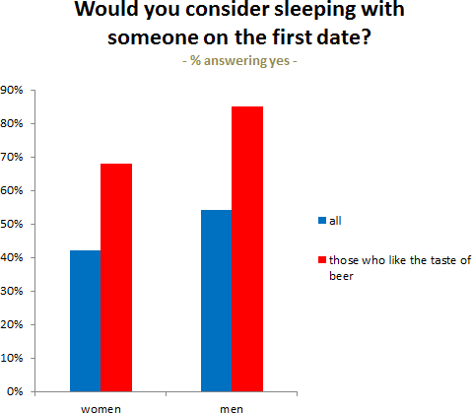
Bar Graph
© Humor Rainbow, Inc. All rights reserved. This content is excluded from our Creative Commons license. For more information, see http://ocw.mit.edu/fairuse.
101
http://blog.okcupid.com

Slide 102

Scatter Plot
© Humor Rainbow, Inc. All rights reserved. This content is excluded from our Creative Commons license. For more information, see http://ocw.mit.edu/fairuse.
102
http://blog.okcupid.com

Slide 103

Line Graph
© Humor Rainbow, Inc. All rights reserved. This content is excluded from our Creative Commons license. For more information, see http://ocw.mit.edu/fairuse.
103
http://blog.okcupid.com

Slide 104

Choropleth Plots
© Humor Rainbow, Inc. All rights reserved. This content is excluded from our Creative Commons license. For more information, see http://ocw.mit.edu/fairuse.
104
http://blog.okcupid.com

Slide 105

Box Plots

Slide 106
Directed Signed Network Graphs

Slide 107

In the context of biological network (brain signals) - beta wave pattern at single trials
Takahashi, et al., Nature Comm 2015

Slide 108

Beta wave propagation directions
Despite loaded arm condition, beta wave propagation directions are along rostral-caudal axis
Takahashi, et al., Nature Comm 2015

Slide 109

Dynamic network of Granger Causally related neurons
Temporal evolution of Granger network
Excitatory connection topology around the time of wave onset shows nice bimodal distributions
Takahashi, et al., Nature Comm 2015
Notes:
Networks of significant directed connections on the array at different time windows (top). Red and blue arrows represent excitatory and inhibitory connections, respectively. The time window (in milliseconds) is labeled above each plot, with time zero corresponding to the onset of the visual target. The black dots represent the relative positions of the electrodes on the array where the neurons were detected. Neurons with relatively high firing rates (≥ 1 spike/sec) and narrow spike widths (≤ 8/30 ms) were analyzed. Circular distribution of directed excitatory connections weighted by their strength and normalized by the total number of possible connections in each orientation on the surface of MI (middle). Circular distribution of directed inhibitory connections weighted by their strength and normalized by the total number of possible connections in each orientation on the surface of MI (bottom). b, Number of significant connections at different time windows for both excitatory and inhibitory connections (left), excitatory connections only (center), and inhibitory connections only (right). The lines in different color shades correspond to different subsets of data in the recording session.

